Slide 1
EECS 498 System Design of a Search Engine
Winter 2026
Lecture 8: Processes and threads
Nicole Hamilton
https://web.eecs.umich.edu/~nham/
nham@umich.edu

Slide 2
agenda
details
strategy
processes
threads
producer-consumer relationships

Slide 3
agenda
details
strategy
processes
threads
producer-consumer relationships

Slide 4
details
The group photo survey is now live.
You can use the basic C runtime library but you don’t need any STL beyond <string>, <vector> and <queue> to do any of the homework.
Please do not use STL wrappers around pthread primitives.
You may be able to do something much smarter and more performant in your project but the homework is autograded and it what it is.
Time to get started on the reading.

Slide 5
Hello, Aardvarks.
Here is how your classmates rated your team photo on a 1-to-10 scale. Ten is best.
Survey question | Team average | Class average
Faces are big enough and clear enough that everyone is easily recognizable. Everyone is identified and their names and the name of their team are easily readable. | 9.85 | 9.24
It’s original. It’s clearly their own work. They haven’t just pasted their faces onto someone else’s artwork. | 9.23 | 7.69
It’s attractive and visually appealing. It’s a nice piece of artwork. This could be a poster. | 9.37 | 7.04
It’s funny, clever, or creative. They’ve chosen a clever name and concept. | 9.63 | 7.53
Excellent technical execution. Good composition, use of color, seamless photo editing. They put some effort into this and it shows. | 9.13 | 7.69
Overall average | 9.44 | 7.84
Scaled and rounded to 100 points | 94 | 78
Comments
1. Wow. Blew me away.
2. Great use of turtles on skateboards versus cats.
3. A little obvious AI.
4. You're mean to cats.

Slide 6
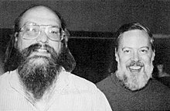
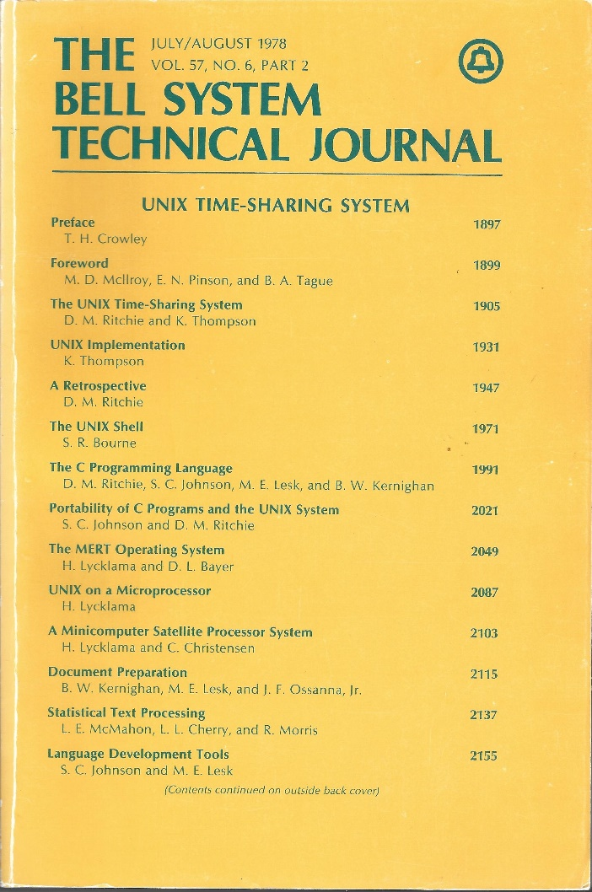
reading list
Please read the first 3 main articles by Dennis Ritchie and Ken Thompson.
http://emulator.pdp-11.org.ru/misc/1978.07_-_Bell_System_Technical_Journal.pdf
Image source: https://en.wikipedia.org/wiki/Dennis_Ritchie#/media/File:Ken_Thompson_and_Dennis_Ritchie.jpg

Slide 7
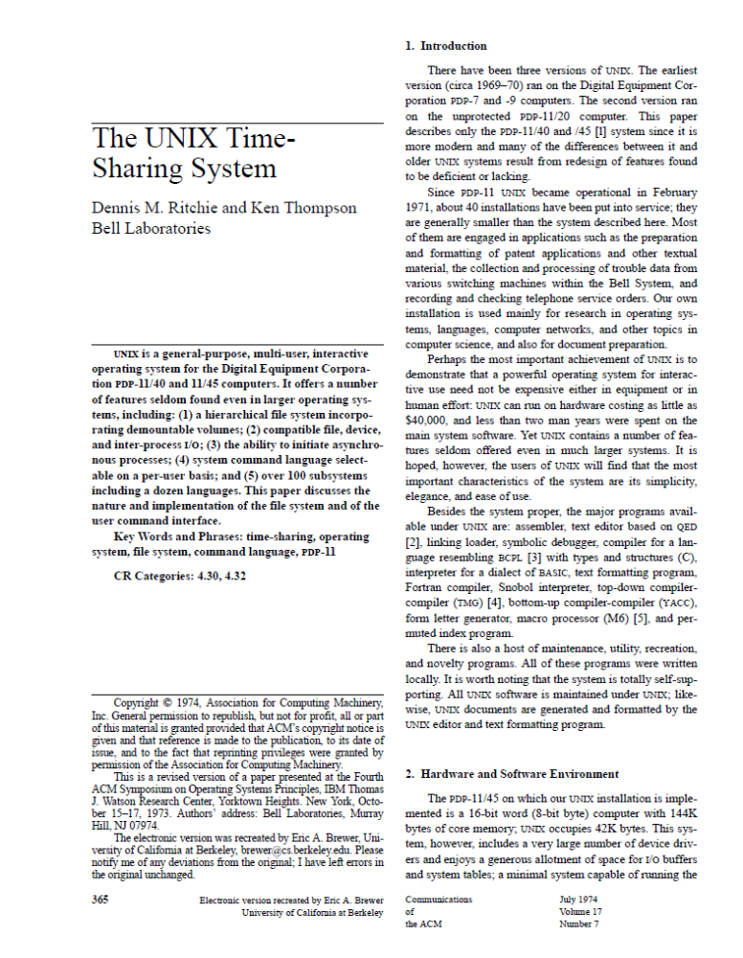
The first one is especially helpful.
Here’s a better PDF.
I may test you on it.
https://people.eecs.berkeley.edu/~brewer/cs262/unix.pdf

Slide 8
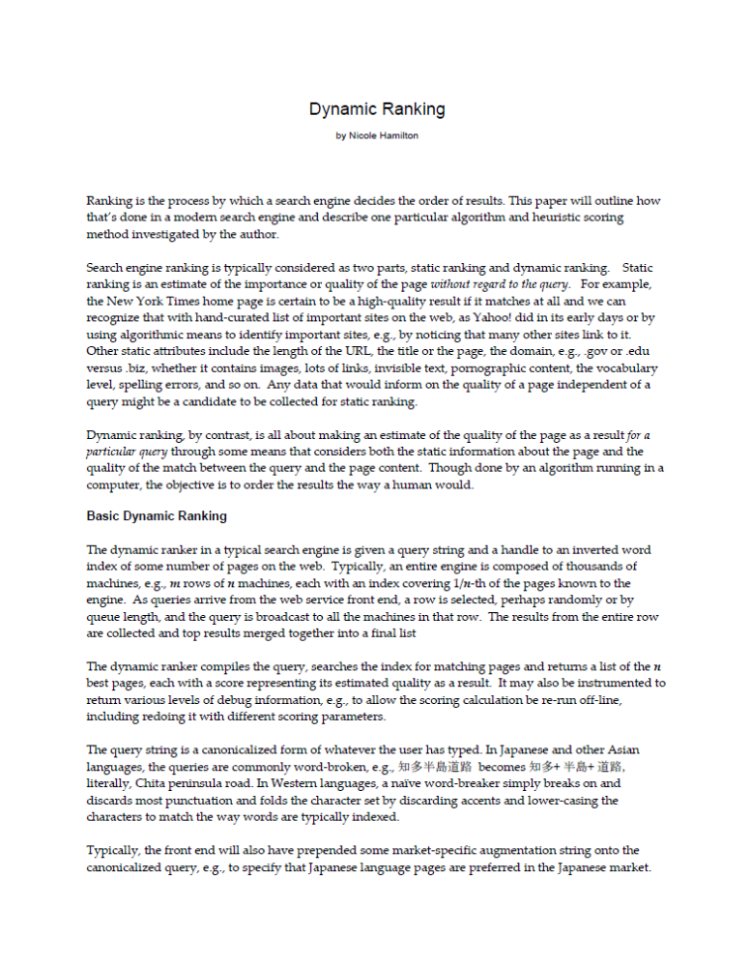
An internal paper I wrote at Microsoft as we prepared to go live in January 2005.
Slightly redacted to gain approval from Microsoft for use in this class.
Posted to Canvas.

Slide 9

I recommend the first 6 chapters.
Posted to Canvas.

Slide 10
agenda
details
strategy
processes
threads
producer-consumer relationships

Slide 11
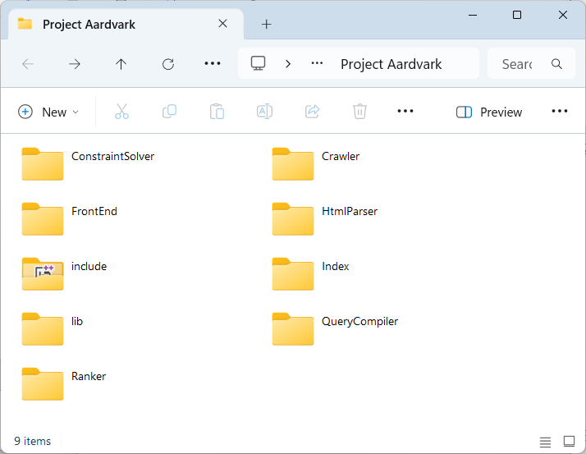
when /where do you start?
Start now.
Begin by laying out your directory structure.

Slide 12
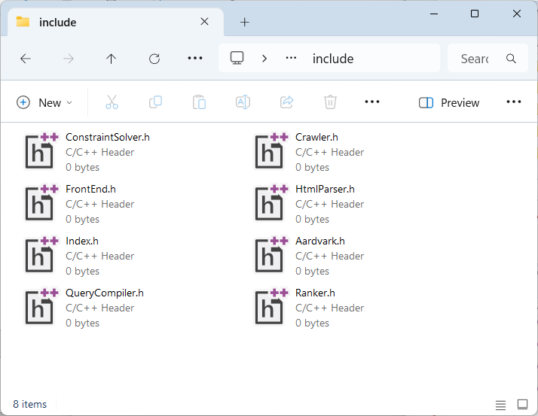
define your interfaces
Create header files that describe the external interfaces.
Agree on the classes and functions you intend to build.

Slide 13
strategy
Expect all your laptops will run the same code, top to bottom.
(If you need a master and your machine is not the master, how would you debug?)
Each should be a complete but standalone engine with all parts.
Get everything working standalone.

Slide 14
distribute crawling
Divide the web across your laptops.
(How could you do that?)
When you discover a new URL, decide which machine owns it.
If it’s yours, add it to your frontier.
If it’s not, add it to list for the machine that does own it.
Periodically batch transfer URLs for the other machines.

Slide 15
distribute querying
When you get a query, broadcast it to the sibling machines.
(Do you send the query string or a compiled version?)
Search your own slice of the web.
Merge the results from the sibling machines.

Slide 16
agenda
details
strategy
processes
threads
producer-consumer relationships

Slide 17
the process model
Each process is protected from other processes.
Owns resources:
  Memory (instructions, stack, data)
  Open handles to files, pipes, semaphores, etc.
Can also share resources, e.g., blocks of memory.
Has “state” information:
  Current directory
  Environment variables
  One or more threads of execution
One-way inheritance to children.

Slide 18
process creation
Linux uses a sequence of two calls to start a process:
  fork( ) creates a copy of current process.
  exec( program, args ) replaces current address space with specified program.
Why first copy the process only to overwrite it?
Allows sharing of code, file descriptors, other state information and results in a simple interface.
Windows by contrast, uses a single CreateProcess( ) system call, but requires a very complex set of arguments to deal with all the possible cases.

Slide 19
Windows CreateProcess
There is no fork( ).
Creates the child running a new executable, returns a handle to the child.
argv is passed as a string, not an array.
Child process retrieves the command line with GetCommandLine( ). C runtime turns that into argc, argv.
Slightly complex rules for words containing spaces or quotes.
Lots of options for debugging, etc.
Two versions.
BOOL CreateProcessA(
LPCSTR lpApplicationName,
LPSTR lpCommandLine,
LPSECURITY_ATTRIBUTES lpProcessAttributes,
LPSECURITY_ATTRIBUTES lpThreadAttributes,
BOOL bInheritHandles,
DWORD dwCreationFlags,
LPVOID lpEnvironment,
LPCSTR lpCurrentDirectory,
LPSTARTUPINFOA lpStartupInfo,
LPPROCESS_INFORMATION lpProcessInformation
);
BOOL CreateProcessW(
LPCWSTR lpApplicationName,
LPWSTR lpCommandLine,
LPSECURITY_ATTRIBUTES lpProcessAttributes,
LPSECURITY_ATTRIBUTES lpThreadAttributes,
BOOL bInheritHandles,
DWORD dwCreationFlags,
LPVOID lpEnvironment,
LPCWSTR lpCurrentDirectory,
LPSTARTUPINFOW lpStartupInfo,
LPPROCESS_INFORMATION lpProcessInformation
);

Slide 20
process creation
Linux uses a sequence of two calls to start a process:
  fork( ) creates a copy of current process.
  exec( program, args ) replaces current address space with specified program.
Any problems with child being an exact clone of parent?

Slide 21
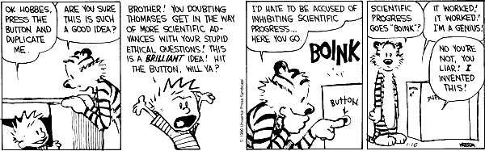
cloning
Need to know which is the parent and which is the child.

Slide 22
fork and exec
Fork uses the return code to differentiate parent from child.
Child gets return code 0.
Parent gets child’s unique process id or pid, which it can wait on for the child to complete.
  int pid = fork( );
  if ( pid == 0 )
  {
  exec (); /* child */
  }
  else
  {
  /* parent */
  int status;
  wait( pid, &status, 0 );
  }

Slide 23
fork bombs
Can easily overwhelm the system by creating thousands of forked copies with malicious code.
  In C++:
  for ( int i = 100; i--; )
  fork( );
  In bash:
  :( ){:|:&};:

Slide 24
copying the address space
Copying an entire address space is expensive.
But Linux is a virtual memory system.
It uses page tables to keep track of what pages of virtual and physical memory belong to what process, which virtual pages are currently in physical memory, and which would have to be fetched from disk.
This allows it to use copy-on-write.

Slide 25
virtual memory
Parent page table
Virtual memory pages
0x00000001
(Refcnt: 1)
0x00000002
0x00000003
(Refcnt: 1)
(Refcnt: 1)
Parent about to fork( ).

Slide 26
copy-on-write
Maintain reference count for each physical page.
On fork( ), copy only the page table of parent.
  Increment reference counts by one.
On store by parent or child to page with refcnt > 1:
  Make a copy of the page with refcnt of one.
  Modify the page table entry of modifier to point to new page.
  Decrement reference count of old page.

Slide 27
copy-on-write
Parent page table
Virtual memory pages
Child page table
0x00000001
(Refcnt: 2)
0x00000001
0x00000002
0x00000002
0x00000003
0x00000003
(Refcnt: 2)
(Refcnt: 2)
Copy-on-write of parent address space.

Slide 28
copy-on-write
Parent page table
Virtual memory pages
Child page table
0x00000001
(Refcnt: 2)
0x00000001
0x00000002
0x00000002
0x00000003
0x00000003
(Refcnt: 1)
(Refcnt: 2)
(Refcnt: 1)
Child modifying page 2 causes a copy to be made.

Slide 29
copy-on-write
Parent page table
Virtual memory pages
Child page table
0x00000001
(Refcnt: 2)
0x00000001
0x00000002
0x00000002
0x00000003
0x00000003
(Refcnt: 1)
(Refcnt: 2)
(Refcnt: 1)
Parent modifying page 2 does not require copying.

Slide 30
copy-on-write
When the parent exits, its page table is deleted and the ref counts decremented.
If a ref count becomes 0, that page is freed.
The child may continue running.
Virtual memory pages
Child page table
(Refcnt: 1)
0x00000001
0x00000002
0x00000003
(Refcnt: 1)
(Refcnt: 1)

Slide 31
making exec() faster
exec( ) initializes code in the address space.
  Naive solution: read file, copy into memory.
  Can we do better?
Observation: most code never accessed.
  Load code on-demand from memory-mapped files.

Slide 32
file-backed vs. swap-backed
Swap-backed pages
  Block on disk chosen by pager.
  A process’s writes to a page visible only to that process.
  Modifications lost after process exit.
File-backed pages
  Block on disk chosen by app.
  Any process’s write to a page visible to other processes that map the same block.
  Modifications persist across process lifetimes.

Slide 33
implementing a shell
Here’s how a shell works.
while ( true )
{
print the prompt;
read the input;
parse into a command + arguments;
fork a copy of the shell process;
if ( child )
{
redirect i/o as requested;
exec the new program with the
specified arguments;
}
else
//parent
if ( !background execution )
wait for child to finish;
}

Slide 34
$ g++ LinuxForkExec.cpp -o LinuxForkExec
$ ./LinuxForkExec wc LinuxForkExec.cpp
parent waiting for child
child starting wc
38 117 861 LinuxForkExec.cpp
child has exited with status = 0
$

Slide 35
#include <sys/types.h>
#include <unistd.h>
pid_t fork(void);
fork() creates a new process by duplicating the calling process. The new process is referred to as the child process. The calling process is referred to as the parent process.
The child process and the parent process run in separate memory spaces. At the time of fork() both memory spaces have the same content.

Slide 36
#include <sys/types.h>
#include <unistd.h>
pid_t fork(void);
The child process is an exact duplicate of the parent process except for the following points:
The child has its own unique process ID.
The child's parent process ID is the same as the parent's process ID.
The child does not inherit its parent's memory locks, timers, pending signals and outstanding asynchronous I/O.

Slide 37
#include <unistd.h>
extern char **environ;
int execl(const char *path, const char *arg, ..., NULL */);
int execlp(const char *file, const char *arg, ...
/* (char *) NULL */);
int execle(const char *path, const char *arg, ...
/*, (char *) NULL, char * const envp[] */);
int execv(const char *path, char *const argv[]);
int execvp(const char *file, char *const argv[]);
int execvpe(const char *file, char *const argv[],
char *const envp[]);
The exec() family of functions replaces the current process image with a new process image.
The initial argument for these functions is the name of a file that is to be executed.

Slide 38
#include <sys/wait.h>
pid_t waitpid(pid_t pid, int *stat_loc, int options);
The waitpid() function suspends execution of the calling thread until child process terminates then returns information about its exit status.

Slide 39
$ g++ LinuxForkExec.cpp -o LinuxForkExec
$ ./LinuxForkExec wc LinuxForkExec.cpp
parent waiting for child
child starting wc
38 117 861 LinuxForkExec.cpp
child has exited with status = 0
$

Slide 40
#include <sys/types.h>
#include <unistd.h>
#include <sys/wait.h>
#include <iostream>
using namespace std;
int main( int argc, char **argv )
{
if ( --argc == 0 )
{
cerr << "Usage: LinuxForkExec command arguments" << endl;
return 1;
}
pid_t processId = fork( );
if ( processId )
{
// parent process
cout << "parent waiting for child" << endl;
int waitStatus;
waitpid( processId, &waitStatus, 0 );
cout << "child has exited with status = " << WEXITSTATUS( waitStatus )
<< endl;
}
else
{
// child process
argv++;
cout << "child starting " << *argv << endl;
execvp( *argv, argv );
cout << "this never prints" << endl;
}
}

Slide 41
agenda
details
strategy
processes
threads
producer-consumer relationships

Slide 42
processes vs. threads
Processes provide concurrency between applications.
Threads provide concurrency within an application.

Slide 43
Typically, many running processes
The operating system
Virtual memory, scheduling, file system,
i/o devices
Process 1
Memory image, open files, current directory, a running program.
Process 2
Memory image, open files, current directory, a running program.
Process n
Memory image, open files, current directory, a running program.
…

Slide 44
Processes provide concurrency between applications.
High startup costs.
One-way inheritance.
Lots of “firewalling.”
Errant apps can’t scribble on others.
The operating system
Process 1
Process 2
Process n
…

Slide 45
Within a process
Threads provide concurrency within an application:
Very low cost to spawn.
Only a scheduler entry is created.
Everything else is shared.
No protection between threads.
A process
Thread 1
Thread 2
Thread n
…

Slide 46
A thread is simple flow of control that can be separately scheduled.
A process
Thread 1
Thread 2
Thread n
…

Slide 47
A thread’s “state” consists of:
An instruction pointer,
A stack,
A register set,
Its scheduling priority, and
Any mutexes it owns.
A process
Thread 1
Thread 2
Thread n
…

Slide 48
Every other thread within the process shares:
Memory (instructions and data),
Open handles to files, processes, pipes, etc.,
Current directory, and
Environment variables.
A process
Thread 1
Thread 2
Thread n
…

Slide 49
A child thread begins completely asynchronously unless you create it in a suspended state.
If you have an SMP, the kernel may transparently run any given thread on any given processor.
Usually there’s “affinity” for the last processor a thread on which a thread ran.
A process
Thread 1
Thread 2
Thread n
…

Slide 50
Within a process
Shared process state
Memory image, open files, current directory,
a running program, argc, argv, envp
Thread 1
Instruction pointer,
register set,
stack pointer,
Scheduling priority, locks held
Thread 2
Instruction pointer,
register set,
stack pointer,
Scheduling priority, locks held
Thread n
Instruction pointer,
register set,
stack pointer,
Scheduling priority, locks held
…

Slide 51
the argument for threads
Allows overlapped activities.
Slow activities like I/O can be moved off the critical path.
Just because I/O has stalled doesn't mean you can't do other things while you wait.
Much lighter cost to create a thread than to create a process.
Lower context switching cost when the scheduler picks a new thread.
Much less cost to share objects between threads because they all share the same memory space.

Slide 52
$ head -1 LinuxHelloMT.cpp
// Simple multi-threaded hello world program.
$ g++ LinuxHelloMT.cpp -pthread -o LinuxHelloMT
$ ./LinuxHelloMT
Starting child
Waiting for child
Hello from the child!
Child has exited
$

Slide 53
#include <pthread.h>
int pthread_create(pthread_t *thread, const pthread_attr_t *attr,
void *(*start_routine) (void *), void *arg);
int pthread_join(pthread_t thread, void **retval);
The pthread_create() function starts a new thread in the calling process. The new thread starts execution by invoking start_routine(); arg is passed as the sole argument of start_routine().
The pthread_join() function waits for the thread specified by thread to terminate. If that thread has already terminated, then pthread_join() returns immediately.

Slide 54
// Simple multi-threaded Linux hello world program.
#include <stdlib.h>
#include <pthread.h>
#include <iostream>
using namespace std;
void *Hello( void *p )
{
cout << "Hello from the child!" << endl;
}
int main( int argc, char **argv )
{
cout << "Starting child" << endl;
pthread_t child;
pthread_create( &child, nullptr, Hello, nullptr );
cout << "Waiting for child" << endl;
pthread_join( child, NULL );
cout << "Child has exited" << endl;
}

Slide 55
agenda
details
strategy
processes
threads
producer-consumer relationships

Slide 56
producer-consumer relationships
Basic notion: Two threads that cooperate so that each consumes what the other produces.
Must share data, locking it before any access.
Sleeping when waiting for input.

Slide 57
a multi-threaded cat program
Our multi-threaded cat utility will use one thread to read input and one to write output.
  Activity A consumes empty buffers and produces full buffers.
  Activity B consumes full buffers and produces empty buffers.
  A pool of buffers is used to minimize blocking.
A
B

Slide 58
producer-consumer strategy
When an activity needs input,
  It locks the input list.
  If the input list is not empty then
  It takes an item and releases the lock.
  else
  It clears the “data available” event,
  Releases the lock,
  Sleeps on “data available
  Starts over at the top.
When an activity has output,
  It locks the output list,
  Puts the item on the list, signals “data available” and releases the lock.
We’ll use condition variables for signaling and mutexes for locking.

Slide 59
#include <pthread.h>
pthread_cond_t cond = PTHREAD_COND_INITIALIZER;
int pthread_cond_signal(pthread_cond_t *cond);
int pthread_cond_broadcast(pthread_cond_t *cond);
int pthread_cond_wait(pthread_cond_t *cond,
pthread_mutex_t *mutex);
int pthread_cond_destroy(pthread_cond_t *cond);
A condition variable allows threads to suspend execution until some predicate on shared data is satisfied.
A condition variable must always be associated with a mutex, to avoid the race condition where a thread prepares to wait on a condition variable and another thread signals the condition just before the first thread actually waits on it.

Slide 60
tcsh-9% head -1 LinuxCatMT.cpp
// Linux multi-threaded cat routine.
tcsh-10% wc LinuxCatMT.cpp
131 328 2569 LinuxCatMT.cpp
tcsh-11% g++ --std=c++17 LinuxCatMT.cpp -o LinuxCatMT
tcsh-12% ./LinuxCatMT < LinuxCatMT.cpp | wc
131 328 2569
tcsh-13%

Slide 61
// Linux multi-threaded cat routine.
#include <unistd.h>
#include <stdlib.h>
#include <pthread.h>
struct Buffer
{
char Block[ 1024 ];
ssize_t Length;
};
template< typename T > struct Node
{
Node *next;
T Data;
Node( ) : next( nullptr )
{
}
};

Slide 62
template< typename T > class SharedList
{
private:
Node< T > *top, *bottom;
pthread_cond_t available;
pthread_mutex_t lock;
public:
SharedList( ) : top( nullptr ), bottom( nullptr )
{
pthread_mutex_init( &lock, nullptr );
available = PTHREAD_COND_INITIALIZER;
}
~SharedList( )
{
pthread_mutex_destroy( &lock );
Node< T > *p;
while ( top )
{
p = top;
top = top->next;
delete p;
}
}

Slide 63
Node< T > *Get( )
{
Node< T > *a;
Node< T > *a;
pthread_mutex_lock( &lock );
while ( !( a = top ) )
pthread_cond_wait( &available, &lock );
if ( ( top = a->next ) == nullptr )
bottom = nullptr;
a->next = nullptr;
pthread_mutex_unlock( &lock );
return a; }
void Put( Node< T > *a )
{
pthread_mutex_lock( &lock );
if ( bottom )
bottom = bottom->next = a;
else
top = bottom = a;
pthread_cond_signal( &available );
pthread_mutex_unlock( &lock );
}
};

Slide 64
SharedList< Buffer > Empty, Full;
void *Reader( void *p )
{
Node< Buffer > *e;
ssize_t length;
do
{
e = Empty.Get( );
e->Data.Length = read( 0, e->Data.Block, sizeof( e->Data.Block ) );
length = e->Data.Length; /* Why? */
Full.Put( e );
}
while ( length > 0 );
return nullptr;
}
void Writer( void )
{
Node< Buffer > *f;
ssize_t length;
while ( f = Full.Get( ), f->Data.Length > 0 )
{
write( 1, f->Data.Block, f->Data.Length );
Empty.Put( f );
}
}

Slide 65
int main( )
{
SharedList< Buffer > empty, full;
// put 5 empty nodes on the empty list;
for ( int i = 5; i--; )
Empty.Put( new Node< Buffer > );
pthread_t child;
/* Spawn the reader as a child thread. */
pthread_create( &child, nullptr, Reader, nullptr );
/* Do the writing in this thread. */
Writer();
}

